Slide 1
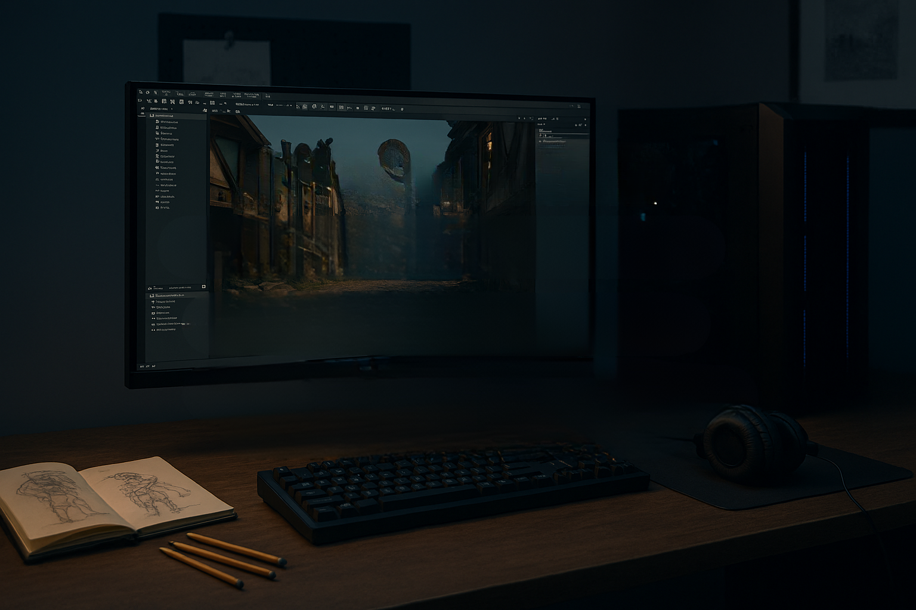


YOUR ULTIMATE
GAMES INDUSTRY
PORTFOLIO GUIDE
Stand out to recruiters and hiring managers with a portfolio that tells your story
Swipe

Slide 2

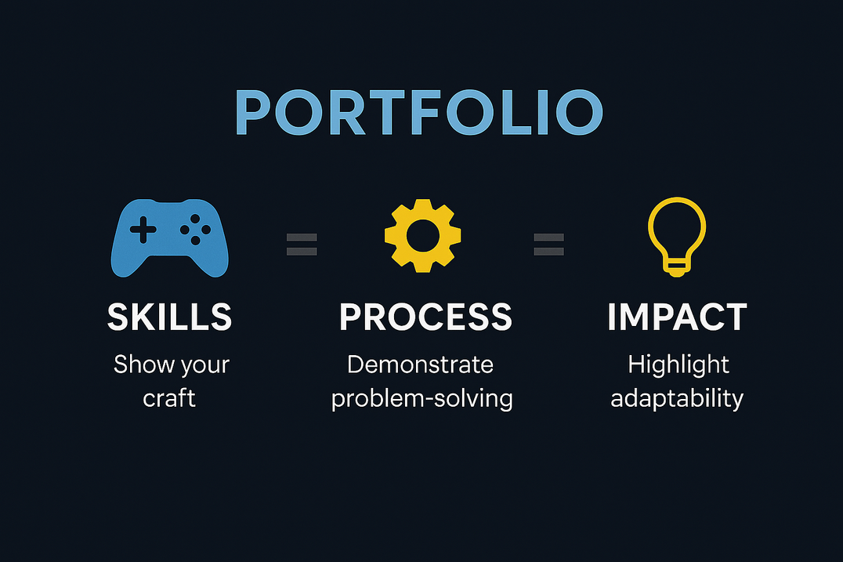

PURPOSE OF YOUR PORTFOLIO
Your portfolio is not just a gallery, its a storytelling tool that demonstrates:
  Your skills and craft (art, programming, design, audio, writing, etc)
  Your thought process (how you solve problems, iterate and collaborate)
  Your adaptability (range of styles, tools, and platforms)
Recruiters and hiring managers want to see evidence of impact, not just pretty pictures or code snippets.
Swipe

Slide 3

CORE PRINCIPLES
ABOUT YOU:
  A concise bio: who you are, your role, and unique values
  Contact details and links to professional profiles (LinkedIn, GitHub, ArtStation, etc)
SHOWCASE PROJECTS:
Quality over quantity: 3 - 5 projects are better than 15 mediocre ones
Include:
  Screenshots or videos (high-quality, compressed for fast loading)
  Role clarity: What exactly did you do? (eg. rigging on the character)
  Tools used: Engines (Unity, Unreal), languages (C++, C#), software (Blender, Maya, Substance)
  Challenges & solutions: Brief notes on problems solved, this shows critical thinking
Swipe

Slide 4

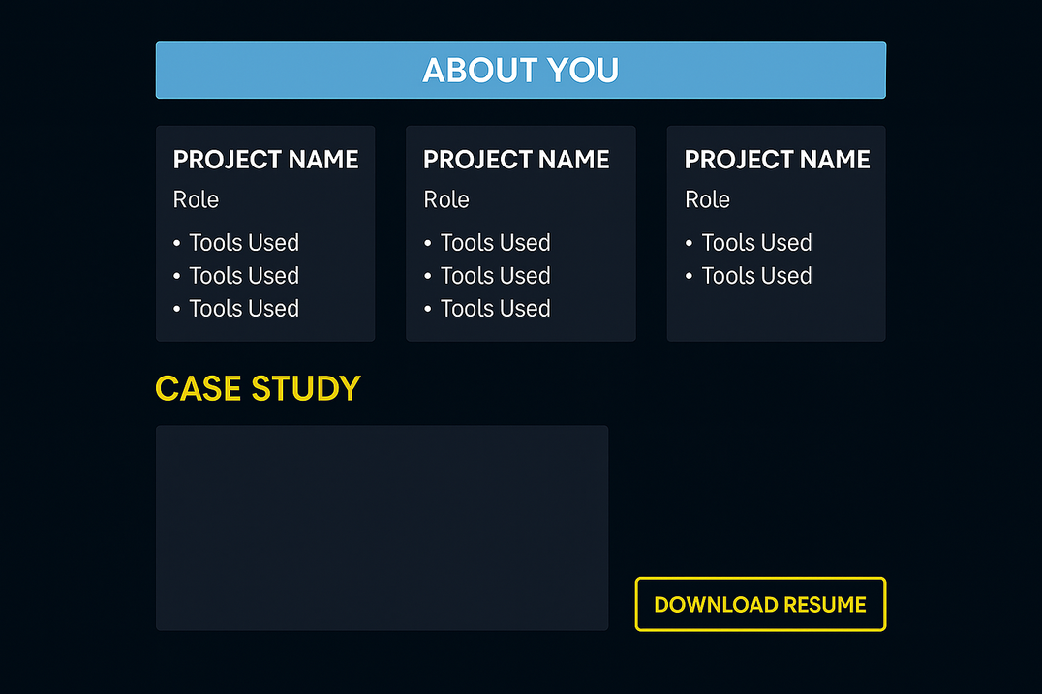
CORE PRINCIPLES
...continued
CASE STUDIES:
Hiring managers love seeing how you think, not just what you made
  Initial concept → iterations → final results
  Include diagrams, prototypes, and reasoning behind design choices
DOWNLOADABLE CV (RESUME):
Keep it updated and aligned with your portfolio
Swipe

Slide 5
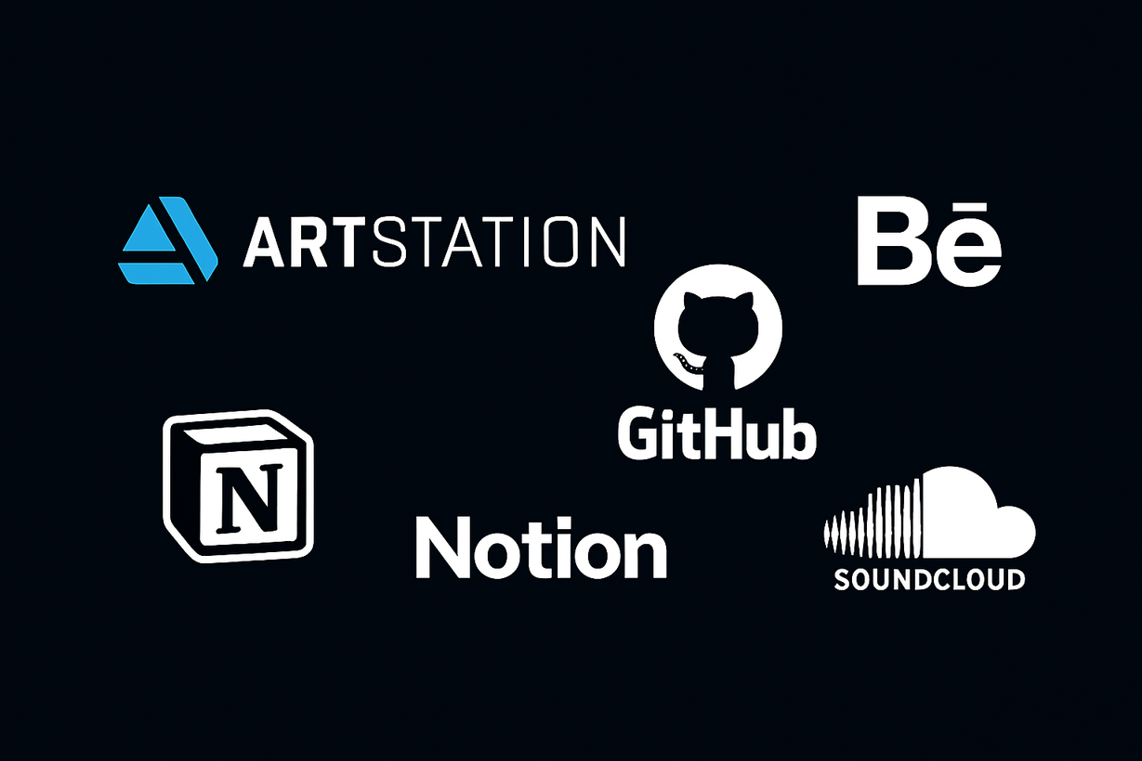
PLATFORMS TO USE
Choose based on your discipline:
  Artists → ArtStation, Behance
  Programmers → GitHub, GitLab
  Designers → Personal site, Notion
  Audio → SoundCloud
  Generalist → Personal domain with embedded links
Swipe

Slide 6


INSIDER TIPS & GEMS
CONTEXT:
PERFORMANCE:
Don’t just show assets, show them in-game or in-engine
Mention optimisation techniques (eg. polycount reduction, shader efficiency)
VERSION CONTROL:
COLLABORATION:
Show Git usage for programmers
Highlight teamwork (eg. “worked with level designers to integrate assets”)
PLAYABILITY:
COLLABORATION:
If possible, provide a downloadable build or short gameplay video
Highlight teamwork (eg. “worked with level designers to integrate assets”)
Swipe

Slide 7

COMMON MISTAKES TO AVOID
Overloading with unfinished work:
Better to show polished pieces
No clear role attribution:
Recruiters hate guessing what you did
Slow loading pages:
Optimise images and videos
Ignore mobile view:
Many recruiters check portfolios on phones
Swipe

Slide 8
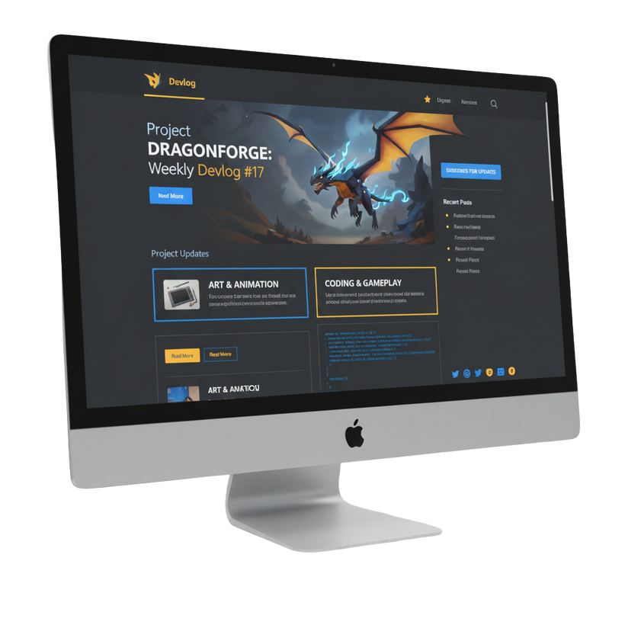
BONUS TIPS
ADD A BLOG SECTION:
Share insights, tutorials or devlogs. It shows passion and communication skills.
INCLUDE METRICS:
If your game had downloads, engagement stats, or awards, mention them!
KEEP BRANDING CONSISTENT:
Fonts, colours, and tone should reflect your professional identity
Swipe

Slide 9
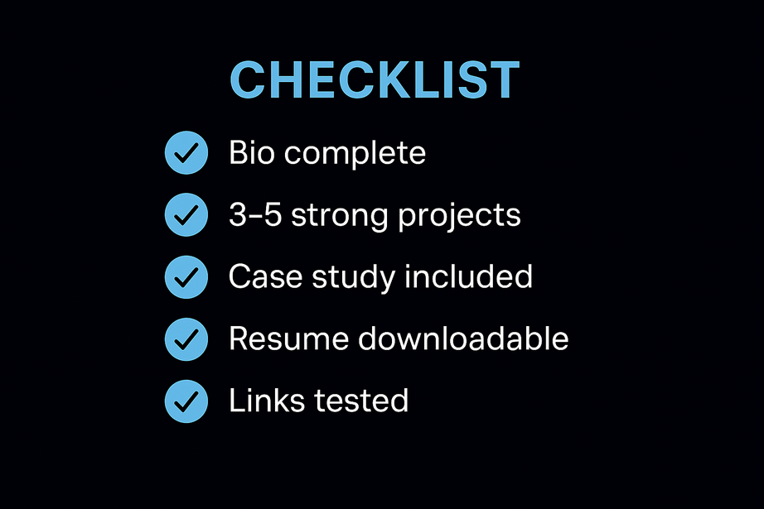

STAND OUT!
Have fun recreating / revamping your portfolio! It not only grabs attention but also demonstrates your creativity, technical skills and problem-solving ability.
Invest time in refining your projects and showcasing your unique contributions, it’s the key to unlocking opportunities!
“Your next role could be just one click away.”
Good luck and may your portfolio open the right doors!

